Slide 1
Steam Games Recommendation System
Sebastian Grassmé
Unsupervised Algorithms in Machine Learning
University of Colorado Boulder
26th of February 2025

Slide 2
Agenda
Introduction
Data Overview
EDA Insights
Correlation Matrix
Top Categorical Values
Distributions
Preparing the Data
Model Results
Conclusion

Slide 3

Introduction
Steam Games Dataset
Make a recommender system to recommend games based on a game title using content-based filtering.
Dataset: https://www.kaggle.com/datasets/fronkongames/steam-games-dataset/data
Goal of recommendation system
Utilizes cosine similarity to measure how closely games are related.
Identifies the top 5 most similar games based on the selected features.

Slide 4
Data Overview
8 of 39 columns
AppID | Name | Release date | Required age | Price | Categories | Genres | Tags
20200 | Galactic Bowling | Oct 21, 2008 | 0 | 19.99 | Single-player,Multi-player,Steam Achievements | Casual,Indie,Sports | Indie,Casual,Sports,Bowling
655370 | Train Bandit | Oct 12, 2017 | 0 | 0.99 | Single-player,Steam Achievements,Full controller sup… | Action,Indie | Indie,Action,Pixel Graphics,2D,Retro
1732930 | Jolt Project | Nov 17, 2021 | 0 | 4.99 | Single-player | Action,Adventure,Indie,Strategy | NaN
1355720 | Henosis™ | Jul 23, 2020 | 0 | 5.99 | Single-player,Full controller support | Adventure,Casual,Indie | 2D Platformer,Atmospheric,Surreal,Mystery,Puzzle
1139950 | Two Weeks in Painland | Feb 3, 2020 | 0 | 0 | Single-player,Steam Achievements | Adventure,Indie | Indie,Adventure,Nudity,Violent
Key Data Columns:
Our dataset contains information like
Price
Required age
Language
Genres
Categories
Tags
Missing Values:
There are missing values in the important columns like Genres, Tags, Categories, which lists the attributes of each game.
Most of the values in the Metacritic url column is null. Which means most games released on steam doesn’t have a Metacritic score.

Slide 5
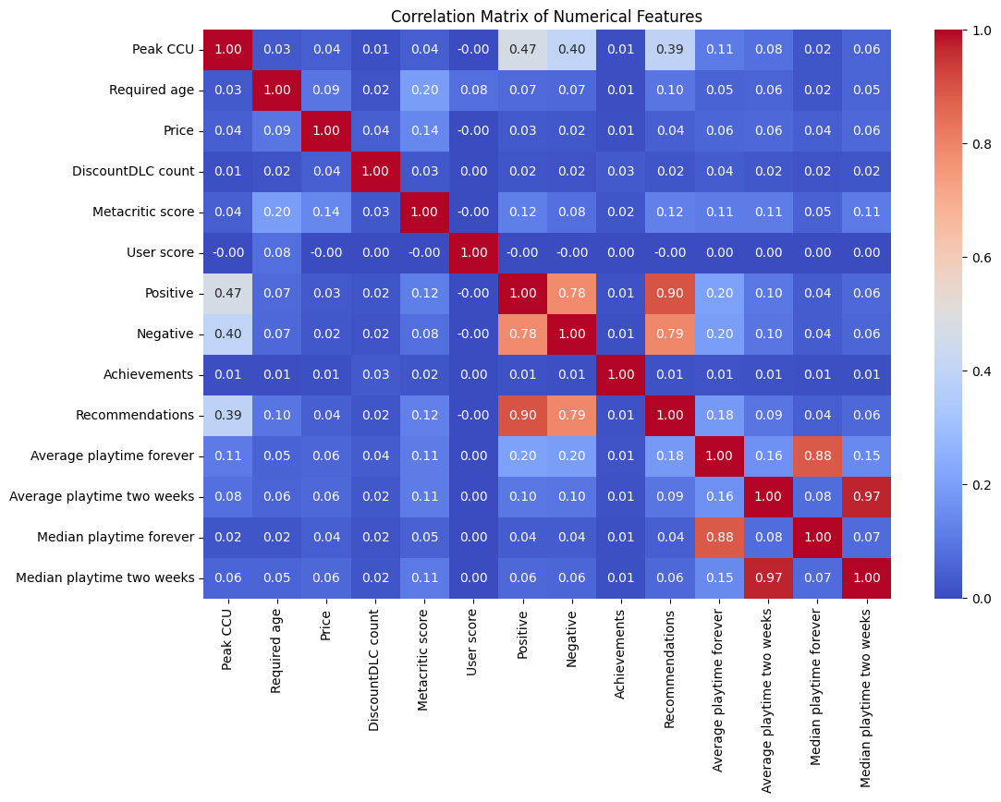
EDA Insights
Correlation Matrix
Strong Correlations
Positive and Recommedations
Negative and Recommendations
Positive and Negative
Peak CCU and Positive
High correlation between between these features indicates that a high number of reviews would mean a popular game. Which also mean more positive reviews lead to higher peak concurrent player count.
Average playtime
Median playtime
Indicate that there dataset doesn’t have many or large outliers.

Slide 6
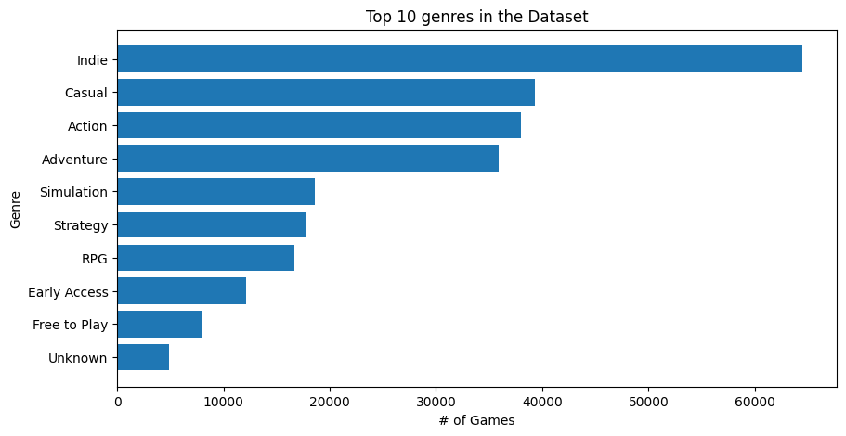
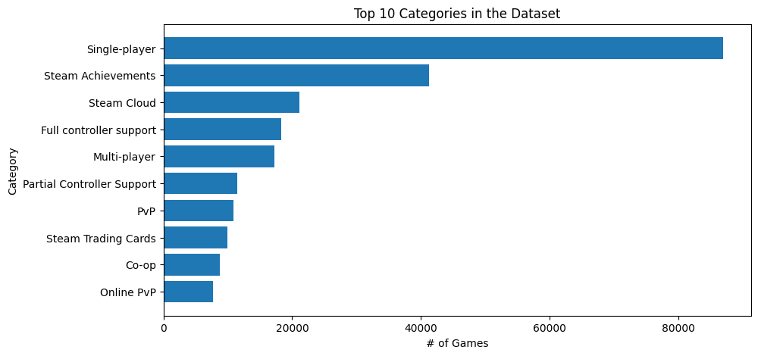
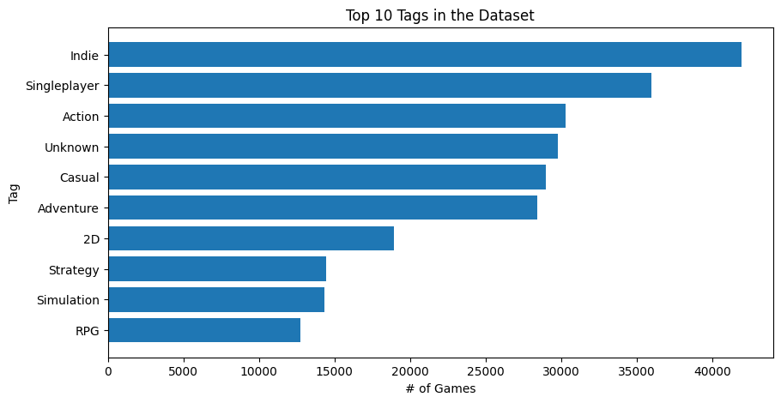
EDA Insights
Top Categorical Values
Top Genres
Top Categories
Top Tags
A lot of indie games.
A fair amount of unknown genre games
Steam’s leading category being Single-player by a large margin.
Once again Indie topping the charg.
Surprisingly many games without any tags (Unknown). This makes using tags less reliable as a feature.

Slide 7
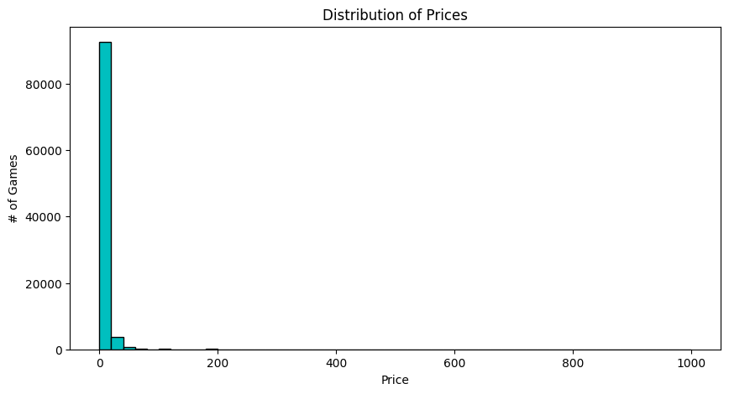
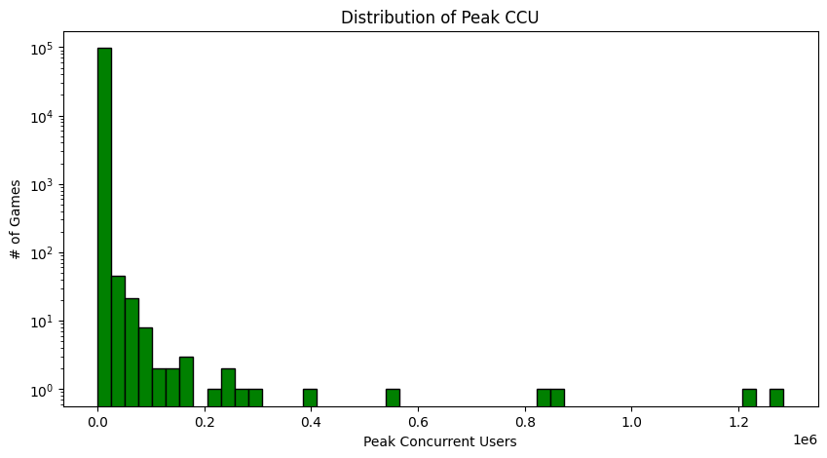
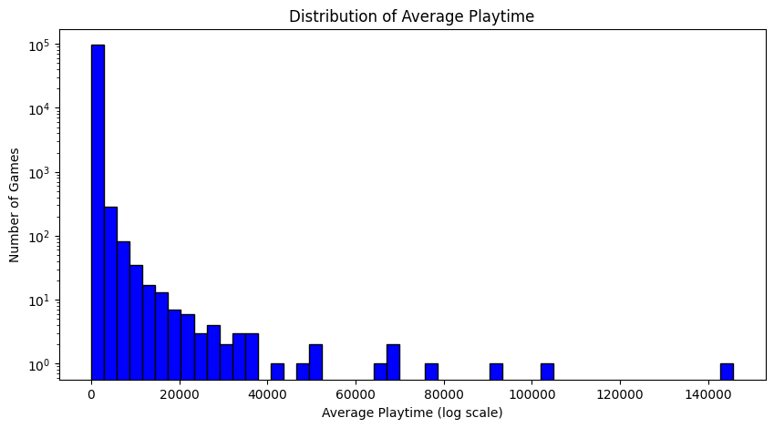
EDA Insights
Distributions
Distribution of Prices
Distribution of Peak CCU
Distribution of Average Playtime
A huge dominance of free games in the dataset.
Interesting to find that most games are ”dead”. With minimal requirements to launch games on the platform this doesn’t surprise me.
This again reinforces the conclusion that most games on steam are dead games with no activity at all.

Slide 8
Preparing the Data
Handling Null Values:
Filled categorial features with Unknown and dropped all columns with mostly null values.
df = df.dropna(subset=['Name'])
fill_cols = ["Genres", "Categories", "Tags", "Supported languages"]
df[fill_cols] = df[fill_cols].fillna("Unknown")
df.isnull().sum()
One-hot Encoding:
Converted the list of entries inside the categorical columns Genres, Tags, Categories and Supported languages into numerical representations.
df["Genres"] = df["Genres"].str.split(",")
mlb_genres = MultiLabelBinarizer()
genres_encoded = pd.DataFrame(mlb_genres.fit_transform(df["Genres"]), columns=mlb_genres.classes_, index=df.index)
df = pd.concat([df, genres_encoded], axis=1)
df.drop(columns=["Genres"], inplace=True)
Normalizing Data:
Used Min-Max scaling for the numerical features to normalize their values.
numerical_features = ["Price", "Peak CCU", "Recommendations", "Average playtime forever", "Required age"]
scaler = MinMaxScaler()
df[numerical_features] = scaler.fit_transform(df[numerical_features])
df[numerical_features].describe()

Slide 9










Model Results
A function was designed to identify and recommend the top 5 most similar games to a given
title using the cosine similarity method.
Games recommended when prompted:
Counter-Strike
Recommendations:
When requesting recommendations for Counter-Strike, I receive similar games
built on the Half-Life engine, which aligns with my expectations.
DayZ
Recommendations:
For DayZ, the recommendations span different genres but maintain a similar overall vibe.

Slide 10
Conclusion
Recommender Model & Performance:
Cosine Similarity provided the most relevant game title recommendations, with an execution time of 0.6s.
Noteable Mentions:
First model attempts with K-means clustering resulted in recommendations that appeared random.
Potential Improvements:
Use of feature reduction like PCA to reduce dimensionality and improve the model’s scalability.
Implement weighted similarity to give more importance to key features, enhancing recommendation accuracy.
With additional data explore mixing content-based filtering with collaborative filtering for more personalized results.

Slide 11
Thank You
Sebastian Grassmé
Unsupervised Algorithms in Machine Learning
University of Colorado Boulder
26th of February 2025

